Slide 1
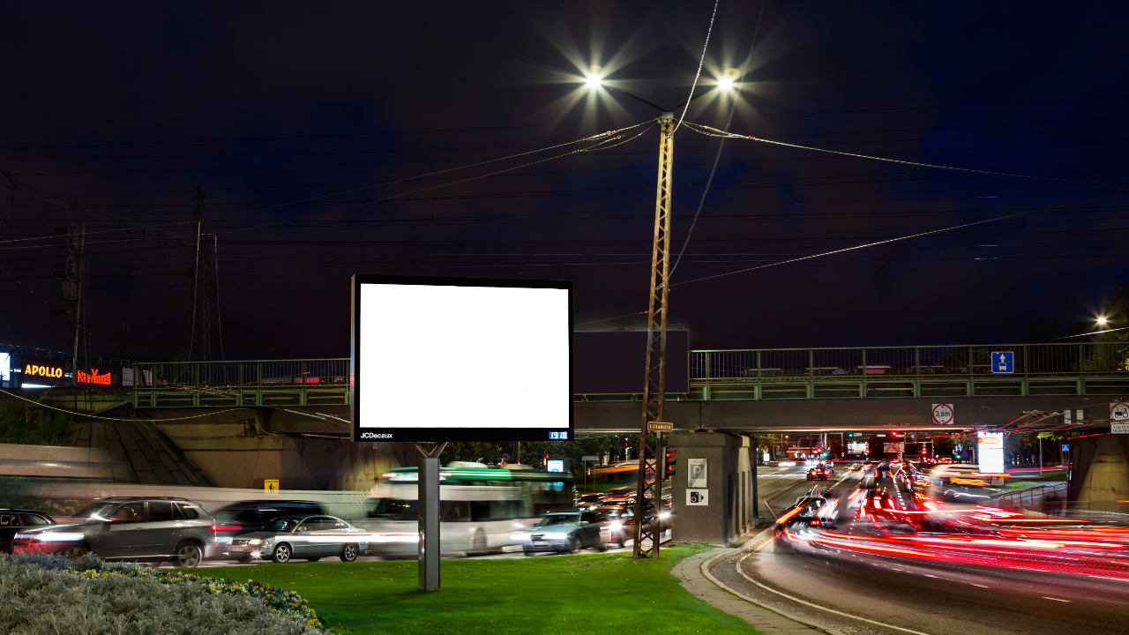

Design of the Digital Poster. DigiTallinn

Slide 2






Your journey towards your first digital poster!
The DigiTallinn network of digital screens is mainly directed towards people using an automobile for moving around in the city of Tallinn. The peculiarity of that being the fact that the messages have to be received very quickly and during movement. The following instructions are based on our experiences with the network in Tallinn and in addition on JCDecaux Group‘s digital dealings from 40 countries around the world. Our guidelines take into account practical beliefs and the restrictions of the environment where the ad is displayd. We would be glad to answer your questions and to provide an alternative opinion on your design- digital@jcdecaux.ee.

Slide 3
THE BASIS OF A DIGITAL POSTER
Digital poster is not a video clip. Do not use more than two different frames
The movements of pictures and text - keep them smooth, simple and steady
Keep the logo and/or product on the poster at all times
Avoid filters and shading. Simple objects with clear contours are well seen and visible
The main message behind the poster should be understandable during whatever second of the poster
Adapt your design- use the possibilities the screens offer. Alter your message according to the time of the day, the weather etc
Keep the number of elements reasonable, a short message and a simple font always work the best
JCDecaux Dynamic opportunities can make your poster come alive. Show the public dynamic ads live on the streets during your campaign
Using contrasts is the basis of visibility
The poster is complete until there are no more elements to remove from it

Slide 4

Digital poster is not a video clip. Do not use more than two different frames. The main idea behind the poster should be clear to the viewer on any second of the digital poster. This is the main starting point of an effective digital poster!

Slide 5

The most effective digital posters have a minimum number of elements, a short message with a clear font. The animations of the graphics and text must be smooth and steady with no difficult filters or shading. Bigger objects are better to grasp.

Slide 6

The movements of visuals, pictures and text must be in accordance with the regulations of the public streets. As the ads are mostly seen by people moving around in cars, there cannot be anything disturbing or hazardous to the attention of the person considering the traffic environment (flashes, blinking, fast movement etc.)

Slide 7

To recognize the advertiser and to be able to memorize the poster, it is vital that the logo and/or product is prominent and visible on the poster at all times. While designing the poster, picture yourself driving the car and seeing an ad on the street for a maximum of three seconds.

Slide 8

Focus on one message and idea, display your main message clearly and with a font size fit for the outdoor. Use the contrasts to emphasize your message and poster on the streets even further.

Slide 9





CONCLUSIONS - THE MAIN THINGS TO REMEMBER OF AN EFFICIENT DIGITAL POSTER
Optimal number of elements, short message with a clear font
Minimal or no frame changes
A product and advertiser recognized on any given moment of the digital poster
The use of contrasts
Product and/or logo visible at all times
Smooth background/ picture/ text animations
One clear main message
Big and visible objects

Slide 10
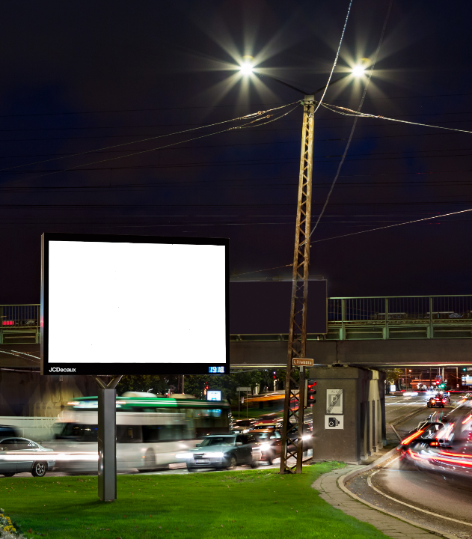

Thank You!
JCDecaux Estonia
Tartu mnt.18, 10115 Tallinn
+372 630 9940
digital@jcdecaux.ee

